Slide 1


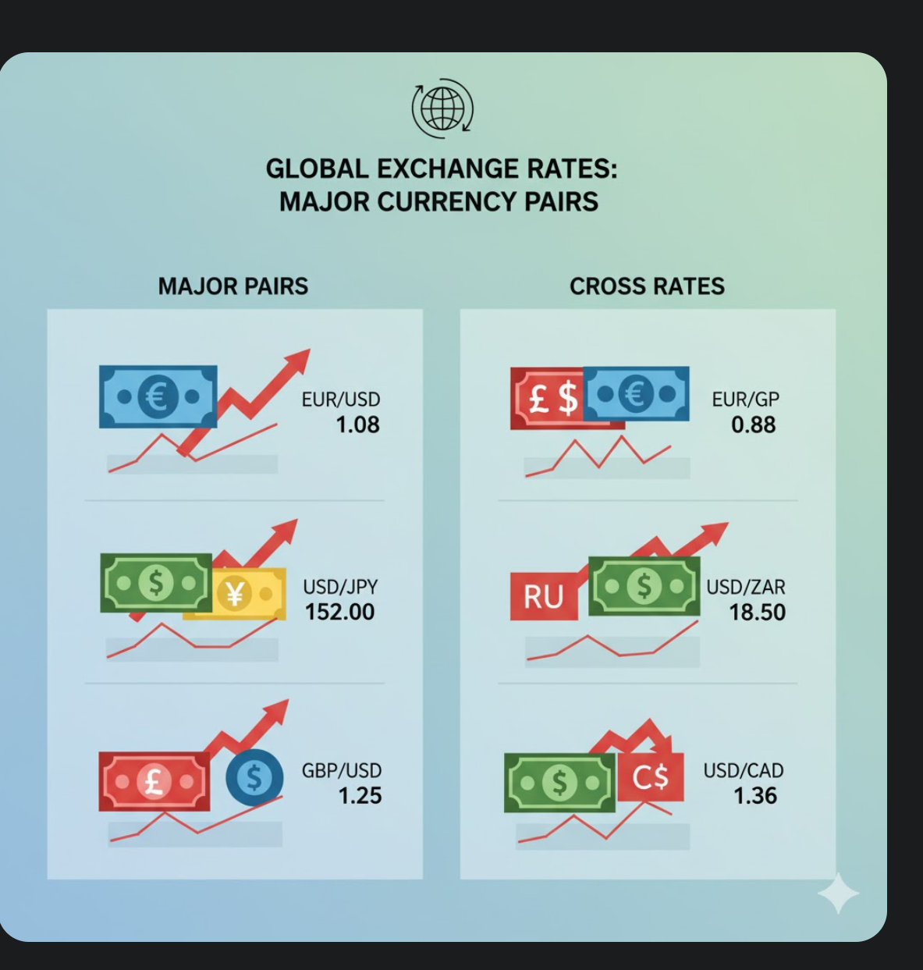

Unit 7
Macroeconomic policy in the global economy

Slide 2
OUTLINE
Recap (Unit 5)
Nominal, real and real effective exchange rates
Exchange rate regimes
Exchange rate regimes in practice
Government deficits and foreign debt

Slide 3
A. Recap

Slide 4
Unit 5 recap
A model of an economy where an independent central bank sets the policy interest rate in response to shocks with the objective of keeping inflation reasonably close to target.
The ultimate determinant of inflation is the central bank’s target inflation rate. The central bank adjusts the interest rate to alter aggregate demand, so as to keep unemployment close to equilibrium, where inflation is constant.
To the extent that it is perceived as successful in pursuing the inflation target, this can help to anchor inflation expectations, and thereby reduce the output and employment costs of getting inflation under control.

Slide 5
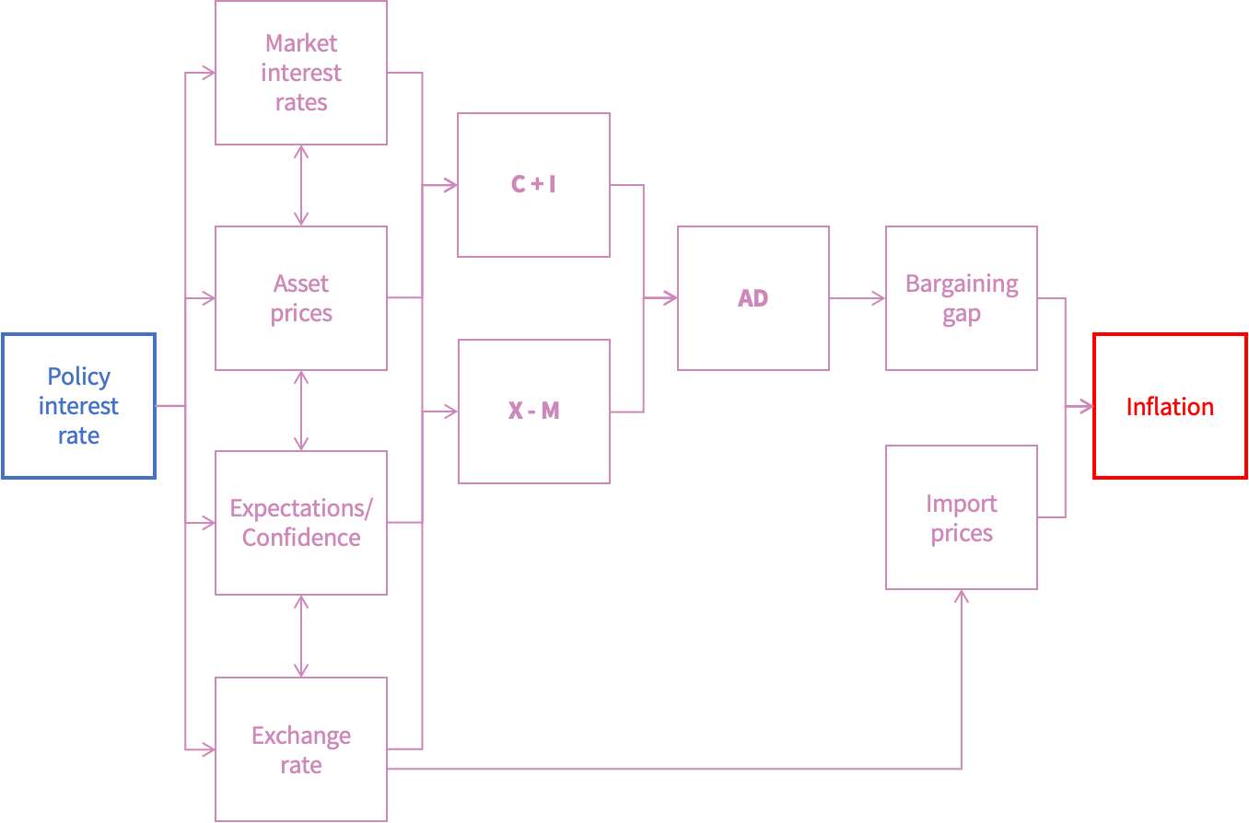
Unit 5 recap

Slide 6
B. Nominal, real and real effective exchange rates

Slide 7
Nominal and real exchange rate
The nominal exchange rate e is the number of units of home currency that must be exchanged to obtain a unit of foreign currency.
The real exchange rate, which is a measure of competitiveness, is given by c = eP*/P where P* and P are the foreign and domestic price levels.
A depreciation of the real exchange rate corresponds to a rise in competitiveness c: it means that domestic goods become cheaper relative to foreign goods.

Slide 8
Real Effective Exchange Rate
The Real Effective Exchange Rate (REER) of the South African rand is a measure of the value of the rand against a basket of currencies of South Africa’s major trading partners, adjusted for differences in inflation between South Africa and those countries.
It shows how competitive South Africa’s goods and services are internationally, after taking into account both exchange rate movements and inflation.

Slide 9
Real Effective Exchange Rate
If the REER rises (appreciates): The rand has become stronger in real terms, meaning South African exports become more expensive abroad and imports become cheaper — a potential loss of competitiveness.
If the REER falls (depreciates): The rand has become weaker in real terms, meaning exports are cheaper and more competitive internationally, but imports become more expensive
Application:
If South Africa’s inflation is higher than that of its trading partners, even if the nominal exchange rate stays the same, the real effective exchange rate will appreciate — reducing export competitiveness.

Slide 10
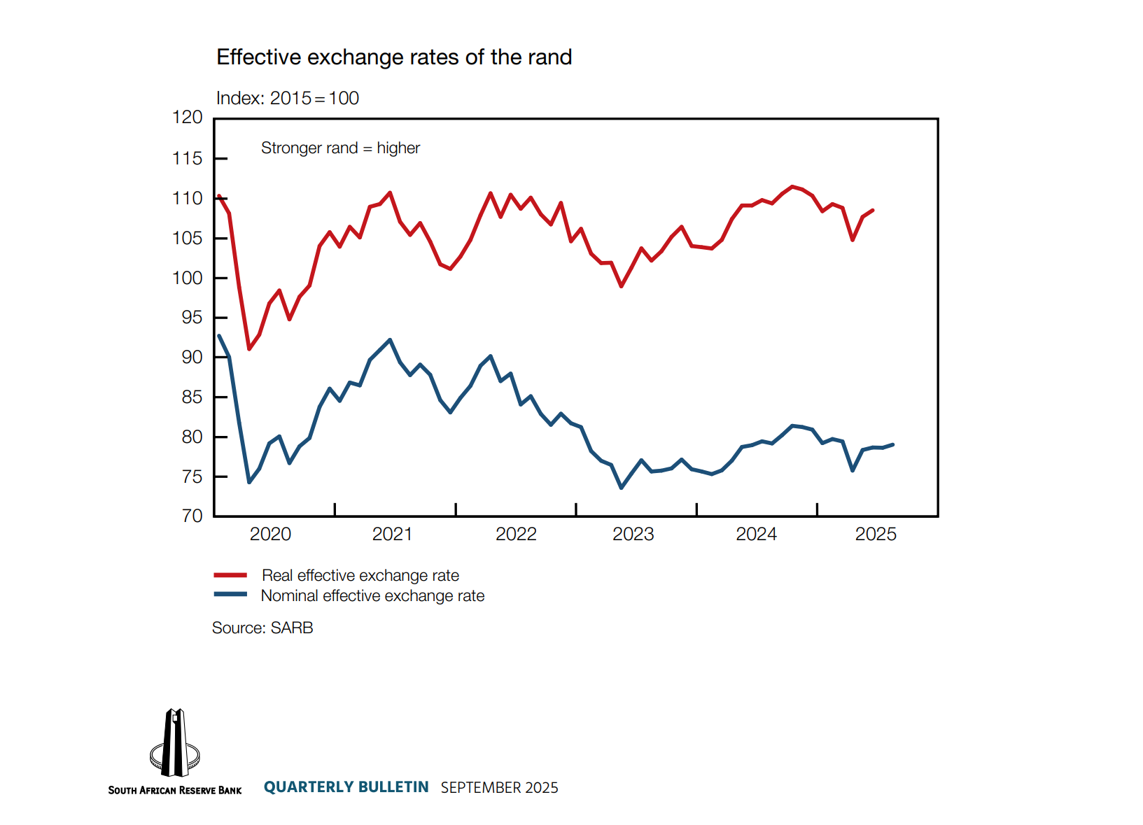
Effective Exchanges Rates of the Rand

Slide 11
C. Exchange rate regimes

Slide 12
Flexible vs fixed exchange rate regimes
In a flexible exchange rate regime, we assume that exchange rates are entirely determined by the interactions of buyers and sellers in the ‘forex’ (foreign exchange) market. Using the policy interest rate to target inflation means it cannot be used to target a specific exchange rate. The country controls its monetary policy but not its exchange rate.
In a fixed exchange rate regime, the government sets the target exchange rate and the central bank manages it. This target can be defined relative to one currency or a basket of currencies. And it may be a specific exchange rate, or a narrow target range, allowing some fluctuation within the range to occur without intervention by the central bank.

Slide 13
Fixed exchange rate regimes
The interest rate cannot be used to manage aggregate demand in the economy if the policymaker wants to keep the exchange rate unchanged or close to a target rate.
The reason is that changing the interest rate to raise or lower aggregate demand will cause a change in the exchange rate, moving it away from the targeted rate.
So countries with a fixed exchange rate do not have the option of using monetary policy to stabilize their economy when there is a demand or supply shock.

Slide 14
Three types of regime
We classify a country’s monetary policy and associated exchange rate regime as one of three types:
FlexIT: A Flexible exchange rate with an Inflation Target (South Africa, UK, Japan)
FlexNIT: A Flexible exchange rate with No stable Inflation Target (Not assessed in Economics 144)
Fix: A Fixed exchange rate (China, EU – common currency area, fixed to each other, flexible to the countries outside EU)

Slide 15
FlexIT
Movements in the exchange rate make monetary policy more powerful, reinforcing the effect of interest rate changes on inflation in two ways:
Via aggregate demand. When the central bank tightens policy, it will anticipate that this will result in both nominal and real exchange rate appreciation, which will dampen net exports and hence output, thus reinforcing the impact of interest rate changes through the aggregate demand channel.
By directly affecting inflation. Changes in the exchange rate also have a powerful direct effect on CPI inflation, via import prices. Tighter policy and exchange rate appreciation dampen inflation and vice versa.

Slide 16
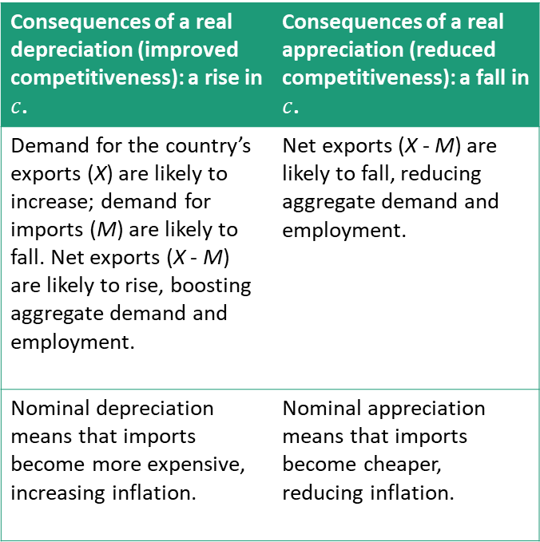
Impacts of depreciation and appreciation
Consequences of a real depreciation (improved competitiveness): a rise in $c$. | Consequences of a real appreciation (reduced competitiveness): a fall in $c$.
Demand for the country’s exports (X) are likely to increase; demand for imports (M) are likely to fall. Net exports (X - M) are likely to rise, boosting aggregate demand and employment. | Net exports (X - M) are likely to fall, reducing aggregate demand and employment.
Nominal depreciation means that imports become more expensive, increasing inflation. | Nominal appreciation means that imports become cheaper, reducing inflation.

Slide 17

Two FlexIT countries
$$c= \frac{e × P^{∗}}{P}$$
Taking the foreign price level P* as given, the formula tells us that there are two ways the real exchange rate can change in a flexible exchange rate regime: either through domestic inflation, or through changes in the nominal exchange rate.
With FlexIT regimes in both the domestic and foreign countries, if they had similar inflation targets and get close to those targets, then P would change at approximately the same rate as P*, so the price ratio P*/P would be reasonably stable.
As a result, in a FlexIT economy, a change in the nominal exchange rate, e, typically translates into a similar proportional change in the real exchange rate, c.

Slide 18
Lecture 2

Slide 19

The ultimate Fix economy
A country within a common currency area does not have its own monetary policy. Base money (reserves and currency) is issued by the shared central bank, which controls the policy interest rate.
The exchange rate for any given member country against countries outside the currency union is the same, and it is determined by the exchange rate of the common currency against other global currencies.
There is still an exchange rate between member countries, but it is e = 1, and this exchange rate simply cannot change.
Thus, a country that belongs to a common currency area is the ultimate Fix economy, with a fixed exchange rate, and interest rates entirely dependent on monetary policy set elsewhere

Slide 20

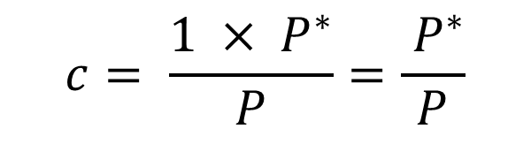
The ultimate Fix economy
For effects on the real economy in a country that is a member of a common currency area, we need to think about the real exchange rate.
It is straightforward to see that fixing the nominal exchange rate does not fix the real exchange rate.
Competitiveness will only remain unchanged if prices in the two countries rise at the same rate.
$$c= \frac{1 × P^{∗}}{P}=\frac{ P^{∗}}{P}$$

Slide 21
FlexIT vs ultimate Fix
FlexIT economy: The reversal of aggregate demand can be quite rapid. The central bank’s increase in the policy interest rate immediately causes an appreciation of home’s nominal exchange rate. Foreign exchange markets respond fast to changes in the interest rate. Prices respond more slowly so for given values of P and P*, this would also imply a real appreciation, offsetting the impact of the demand shock.
Common currency area (extreme case of a ‘Fix’ regime): Since home’s nominal exchange rate cannot change, the aggregate demand shock is only slowly offset as higher domestic inflation produces a gradual real appreciation. If we assume that wages are set annually and prices update after the wage round, the process of real appreciation will be protracted.

Slide 22
Why join a common currency area?
The successful operation of monetary policy in a FlexIT regime relies on the credibility of the government’s commitment to the independence of the central bank. Unless the government can make a credible commitment to delegate monetary policy fully and permanently, and set a stable inflation target, a common currency zone will tie its hands more securely.
Different currencies would be inconvenient (and costly) for trade of goods and services for a group of countries that have a lot of cross-border trade. This is a key motivation for the formation of a common currency area.

Slide 23
Arguments for joining common currency area
1. Elimination of Exchange Rate Uncertainty
By adopting a common currency, countries remove the risk of exchange rate fluctuations within the union.
This encourages trade and investment across member countries because firms and households don’t need to worry about currency depreciation/appreciation.
2. Lower Transaction Costs
Businesses and consumers no longer need to convert currencies, which reduces banking and exchange costs.
This is particularly important in regions with high levels of cross-border trade.

Slide 24
Arguments for joining common currency area
3. Price Transparency
A common currency makes it easier for consumers and businesses to compare prices across countries.
Increased competition tends to lower prices and improve efficiency.
4. Deeper Economic Integration
Sharing a currency can strengthen economic and political ties between member countries.
It facilitates the free flow of goods, services, capital, and even labor.

Slide 25
Arguments for joining common currency area
5. Monetary Stability and Discipline
Membership often requires countries to meet strict fiscal and inflation criteria (e.g., Maastricht criteria for the Euro).
This can encourage governments to maintain sound fiscal and monetary policies, reducing inflationary tendencies.
6. Enhanced Global Influence
A common currency area often creates a stronger and more stable currency that competes internationally (e.g., the euro vs. the US dollar).
This strengthens bargaining power in global trade and financial markets.
7. Boost to Trade and Growth
Studies suggest that joining a currency union can
increase trade among members significantly.
Greater market integration can boost long-term growth.

Slide 26
D. Exchange rate regimes in practice

Slide 27
Fixed exchange rate regimes
A common currency area is the most extreme case of a fixed exchange rate.
In most fixed exchange rate regimes, as conventionally defined, individual countries continue to have their own currency but hold their exchange rates constant against either one, or sometimes multiple, currencies.
Normally we would only refer to a ‘fixed’ exchange rate as such if the government and central bank both commit to, and actually maintain a nominal exchange rate that is either completely fixed, or moves by only very small amounts.

Slide 28
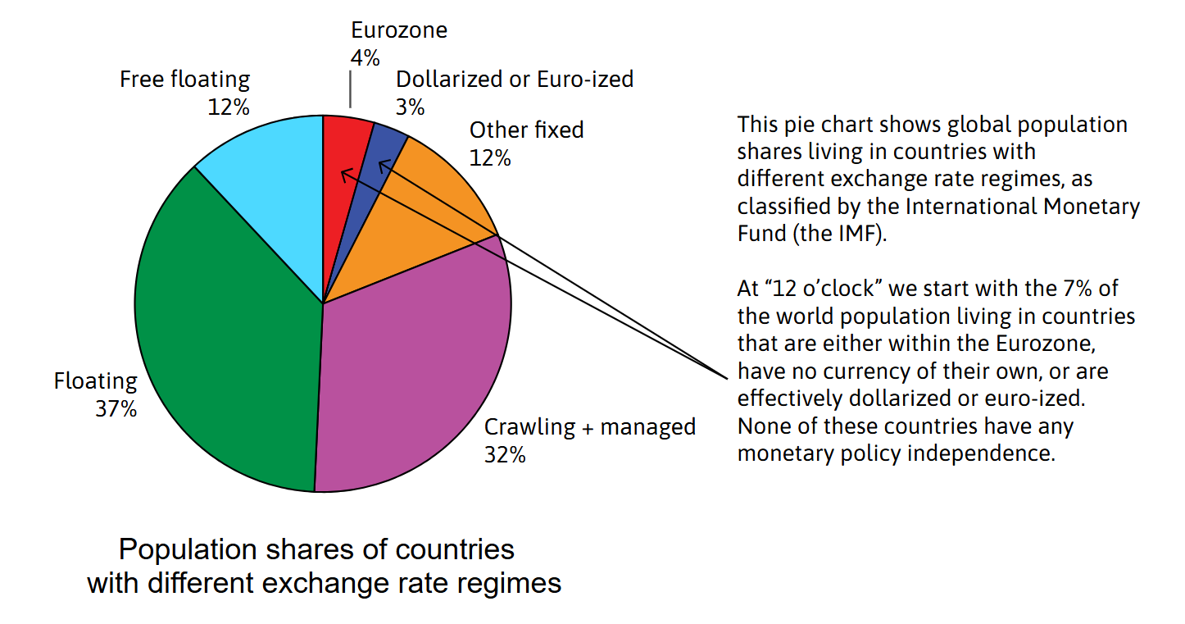
Exchange rate regimes around the world

Slide 29
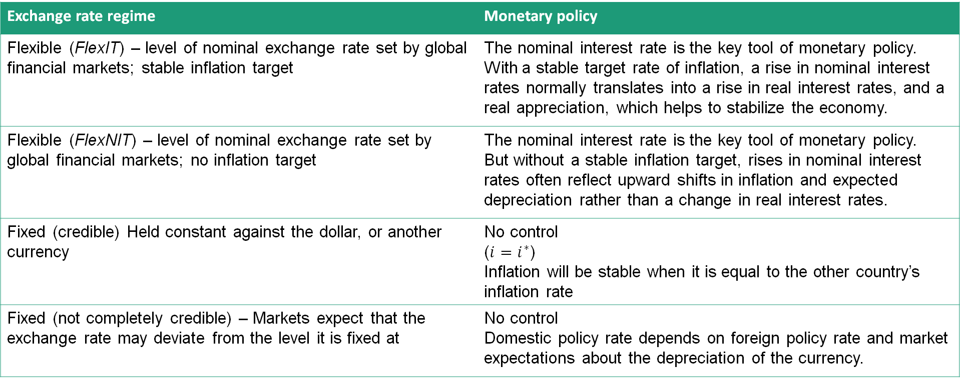
Exchange rate regime = monetary regime
Exchange rate regime | Monetary policy
Flexible (FlexIT) – level of nominal exchange rate set by global financial markets; stable inflation target | The nominal interest rate is the key tool of monetary policy. With a stable target rate of inflation, a rise in nominal interest rates normally translates into a rise in real interest rates, and a real appreciation, which helps to stabilize the economy.
Flexible (FlexNIT) – level of nominal exchange rate set by global financial markets; no inflation target | The nominal interest rate is the key tool of monetary policy. But without a stable inflation target, rises in nominal interest rates often reflect upward shifts in inflation and expected depreciation rather than a change in real interest rates.
Fixed (credible) Held constant against the dollar, or another currency | No control ($i=i^{∗}$) Inflation will be stable when it is equal to the other country’s inflation rate
Fixed (not completely credible) – Markets expect that the exchange rate may deviate from the level it is fixed at | No control Domestic policy rate depends on foreign policy rate and market expectations about the depreciation of the currency.

Slide 30
E. Government deficits and foreign debt

Slide 31
Government deficits and debt
.
An important difference between the government and other economic actors is its ability to extract taxes from citizens—if necessary, with the threat of force. But in many countries around the world, current taxes do not provide sufficient resources to pay for all government expenditure. In that case, the government can choose to borrow.
To be clear, governments may borrow for good reasons, to benefit the economy now or in future. And borrowing need not lead to inflation. Most governments around the world have at least on occasions run large fiscal deficits—meaning that they have spent more than they raised in taxes.

Slide 32
Government deficits and debt
.
But borrowing on a sustainable basis, while keeping inflation under control, frequently proves difficult in FlexNIT countries.
If domestic savings are not high enough to finance the deficit, the government would need to borrow from abroad. When it issues bonds it will need to pay interest on them at a sufficiently attractive rate for foreign lenders to be willing to lend. Foreign investors are often only prepared to lend in foreign currency, usually dollars. This means, the interest rate will typically be higher because of the risk of default.

Slide 33
Sovereign debt crises
.
Note also that the value of foreign debt in domestic currency goes up if the exchange rate depreciates, increasing the burden of the debt on the home country and the likelihood that it will be unable to pay the interest and will default.
This process can lead to debts that spiral upwards. The burden of interest payments on debt may lead to a sovereign debt crisis, when governments default on some or all of their debts.
In the aftermath of such crises, governments in these countries may find themselves unable to borrow in global financial markets. Even if they can borrow, governments may not wish to accept the discipline of repaying the debt in foreign currency that foreign borrowing imposes.

Slide 34
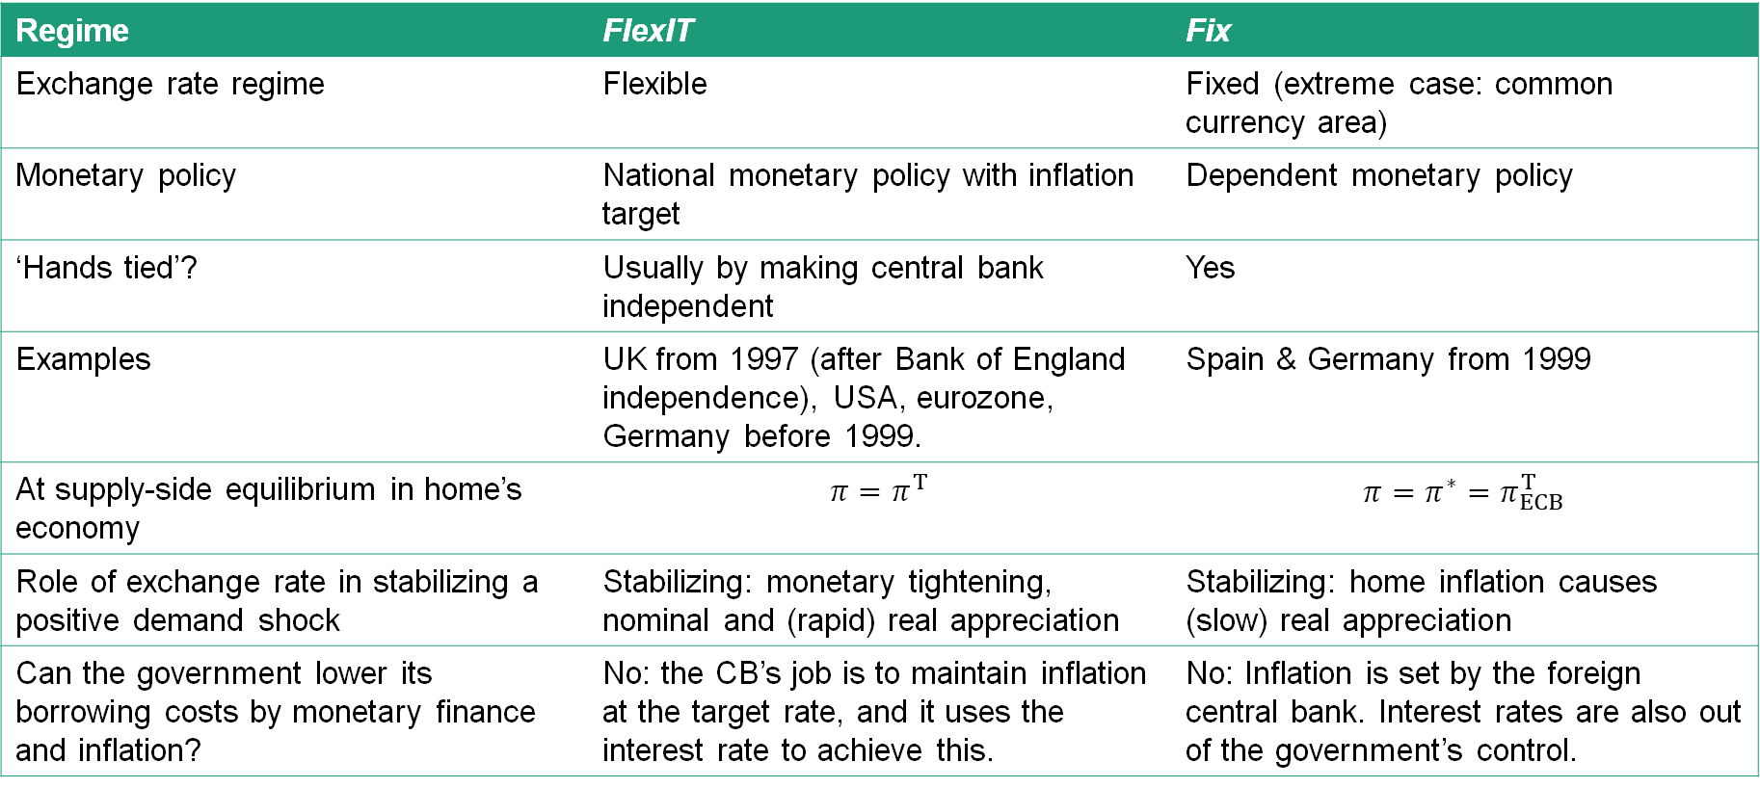
The key themes
Regime | FlexIT | Fix
Exchange rate regime | Flexible | Fixed (extreme case: common currency area)
Monetary policy | National monetary policy with inflation target | Dependent monetary policy
‘Hands tied’? | Usually by making central bank independent | Yes
Examples | UK from 1997 (after Bank of England independence), USA, eurozone, Germany before 1999. | Spain & Germany from 1999
At supply-side equilibrium in home’s economy | $$π=π^{T}$$ | $$π=π^{∗}=π_{ECB}^{T}$$
Role of exchange rate in stabilizing a positive demand shock | Stabilizing: monetary tightening, nominal and (rapid) real appreciation | Stabilizing: home inflation causes (slow) real appreciation
Can the government lower its borrowing costs by monetary finance and inflation? | No: the CB’s job is to maintain inflation at the target rate, and it uses the interest rate to achieve this. | No: Inflation is set by the foreign central bank. Interest rates are also out of the government’s control.

